Slide 1
'History' found in old cameras

Slide 2
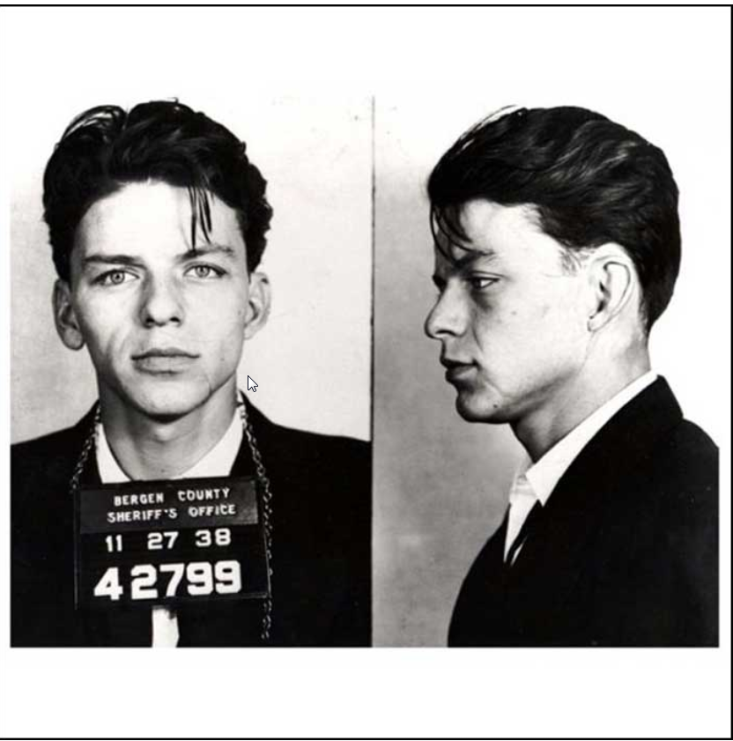
23 year old Frank Sinatra mug shot 1938

Slide 3
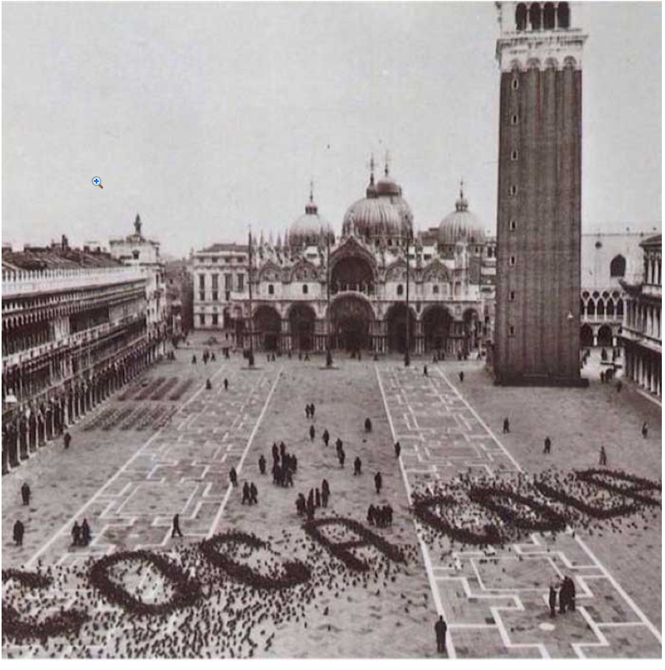
A Coca Cola advertisement made by pigeons in St. Mark's Square, Venice, late 1960s

Slide 4
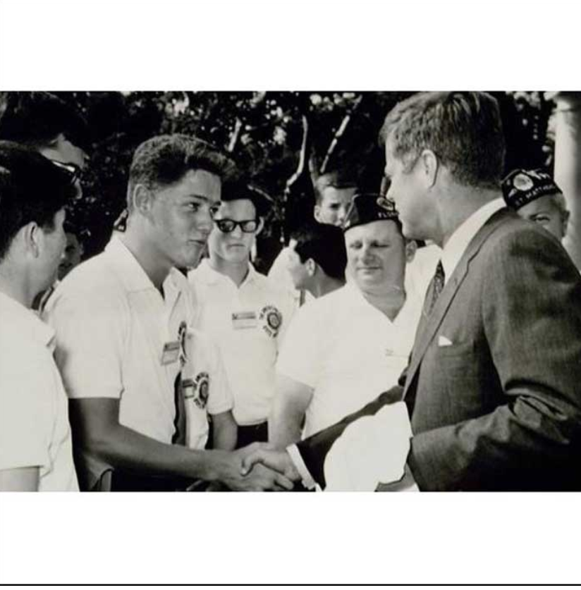
A teenage Bill Clinton meets with John F. Kennedy

Slide 5
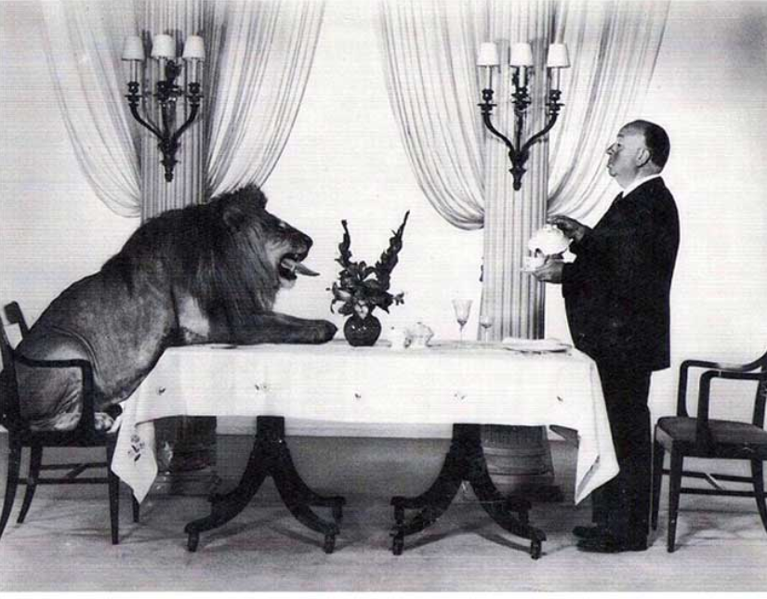
Alfred Hitchcock serving tea to Leo the Lion, MGM's mascot, 1958

Slide 6
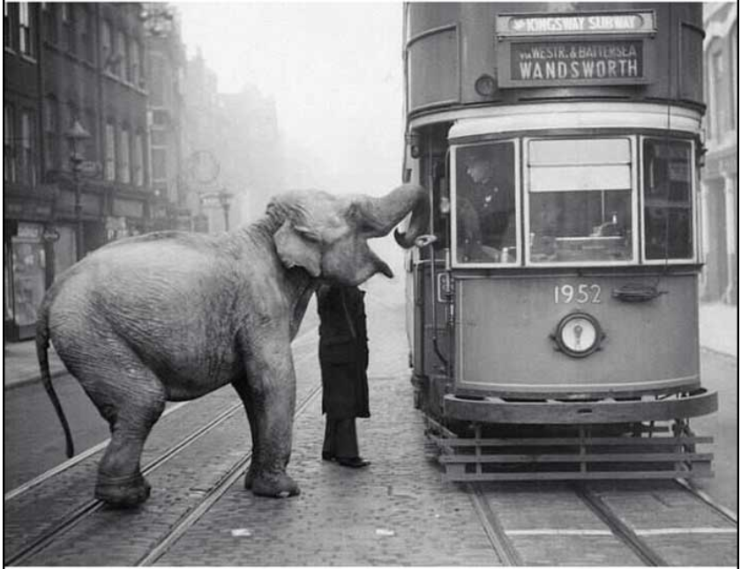
An Elephant stops a tram on Gray's Inn Road, London, to eat an apple from the driver, 1936

Slide 7
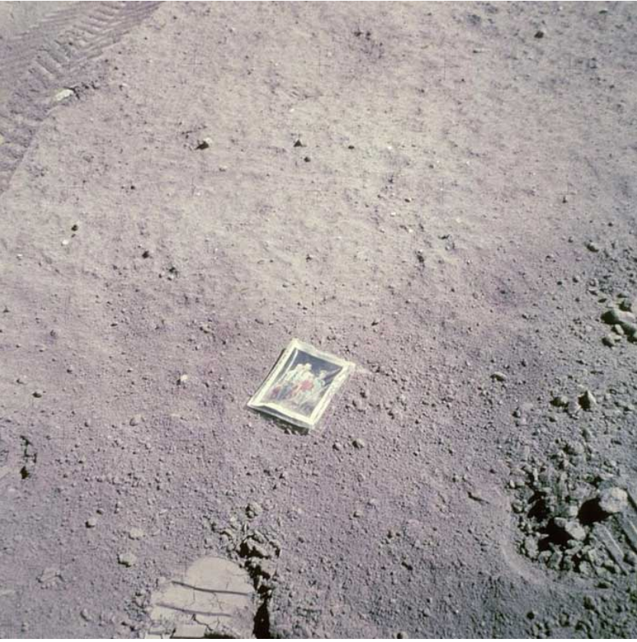
Apollo 16 astronaut, Charles Duke, immortalizes his family by leaving a photo of them on the moon, in 1972

Slide 8
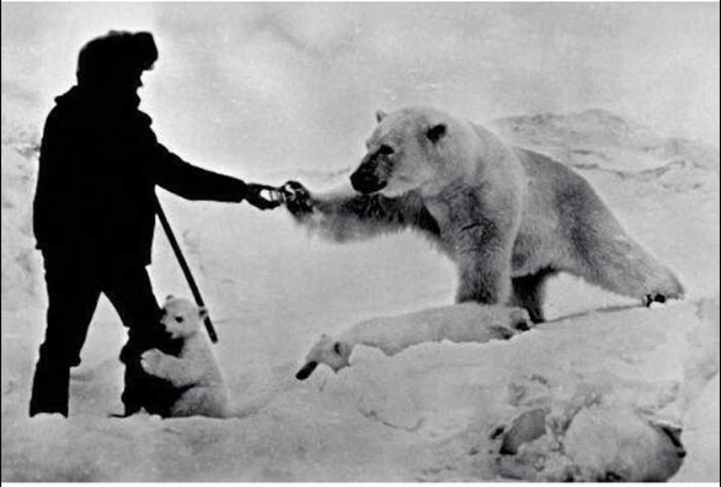
Astonishing photo showing a man feeding a polar bear and his cubs, with milk, Russia, late 1970s

Slide 9
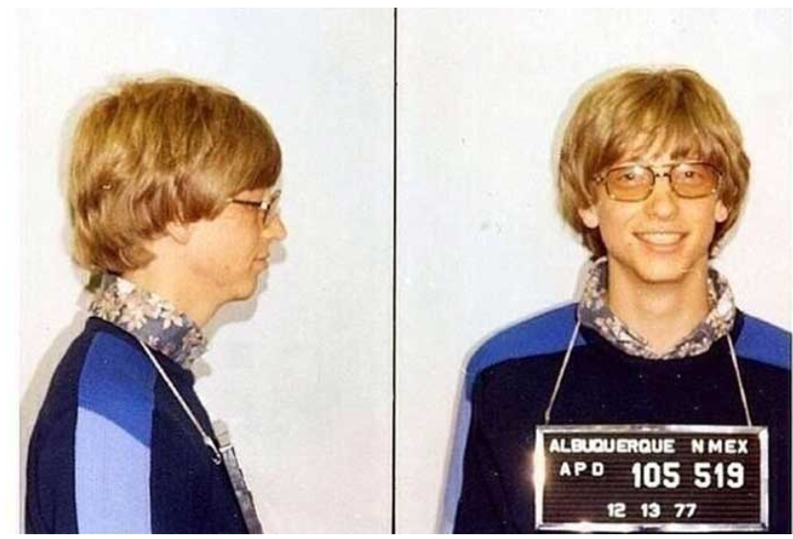
Bill Gates arrested in Albuquerque for speeding in his Porsche

Slide 10
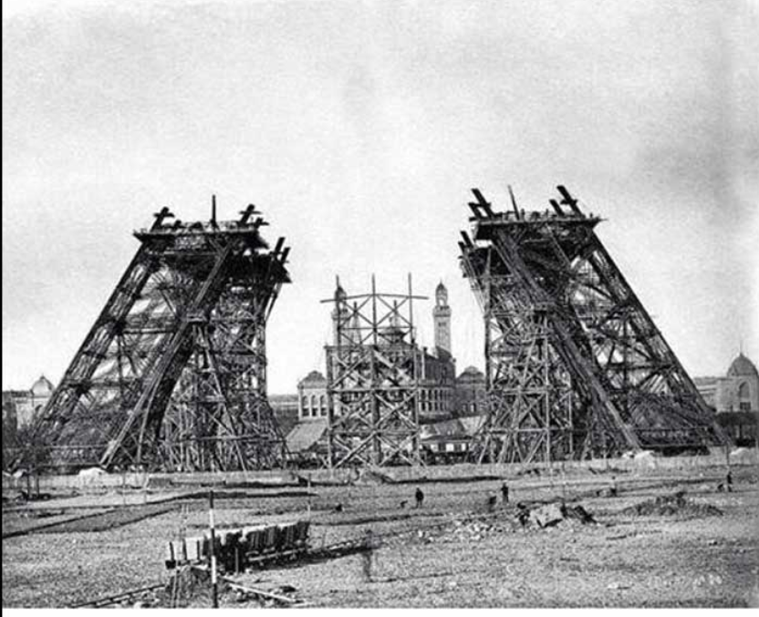
Eiffel Tower under construction, 1887

Slide 11
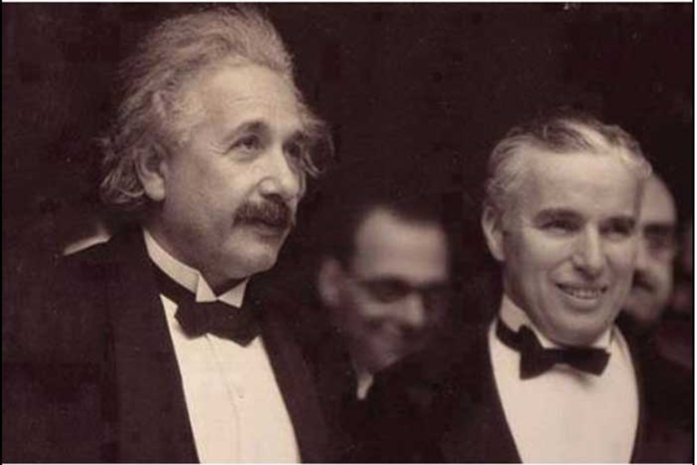
Albert Einstein with Charlie Chaplin

Slide 12
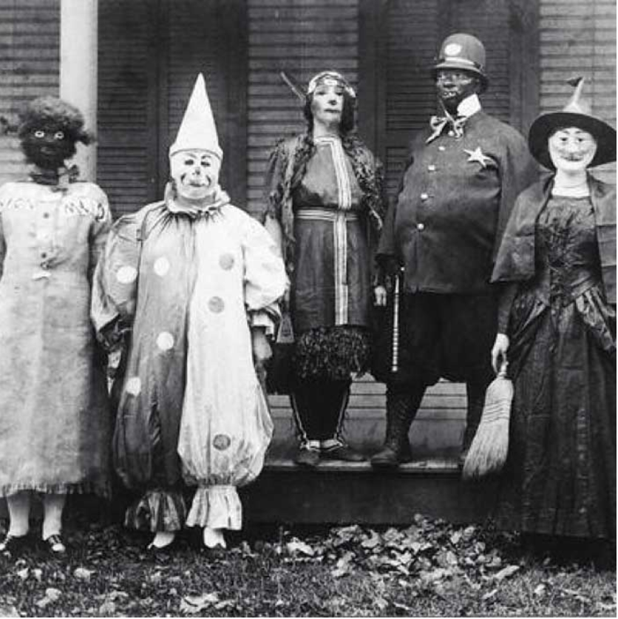
Halloween in the 1900s

Slide 13
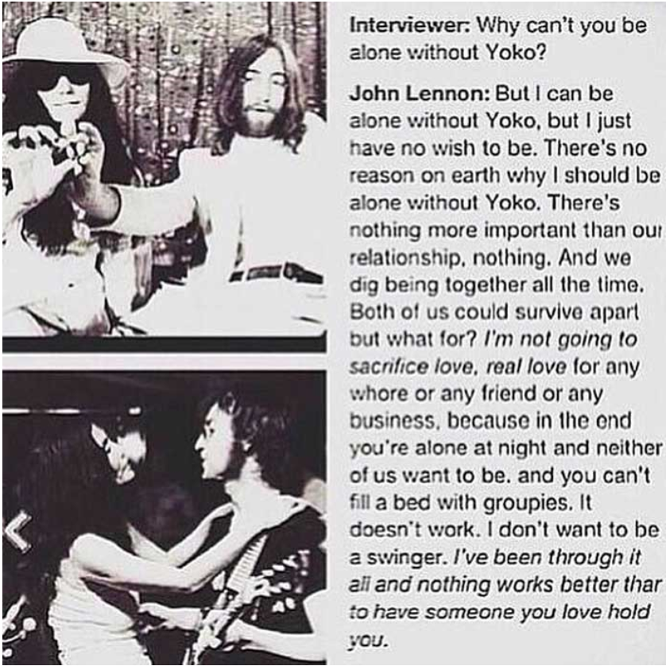
John Lennon explains his relationship with Yoko

Slide 14
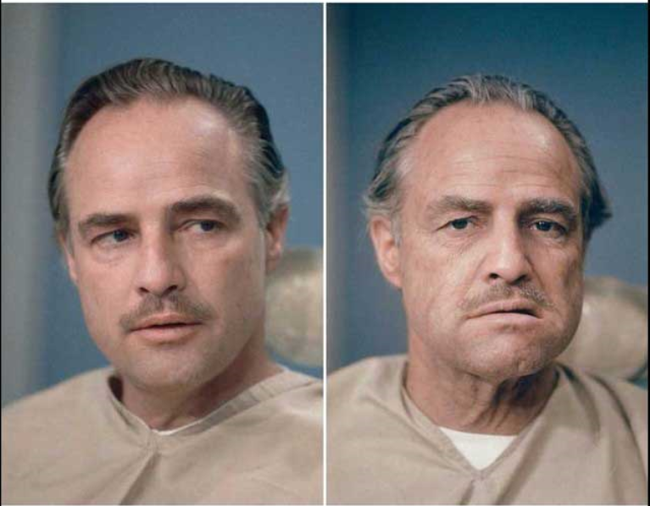
Marlon Brando before, and after, getting his make up done to be Don Vito Corleone, in The Godfather

Slide 15
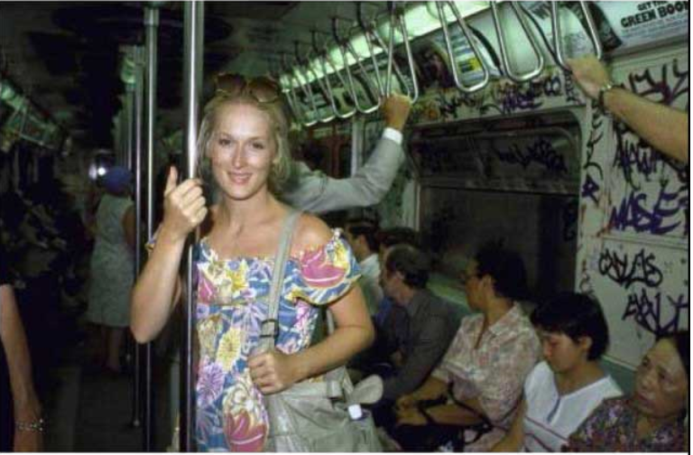
Meryl Streep, New York City subway, 1981

Slide 16
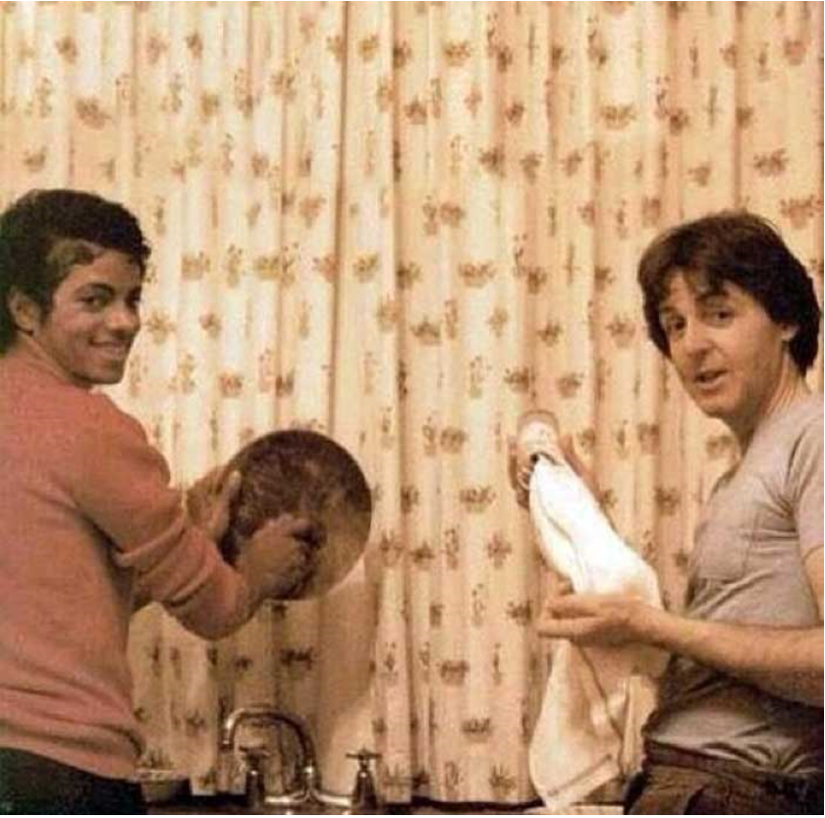
Michael Jackson and Paul McCartney doing dishes

Slide 17
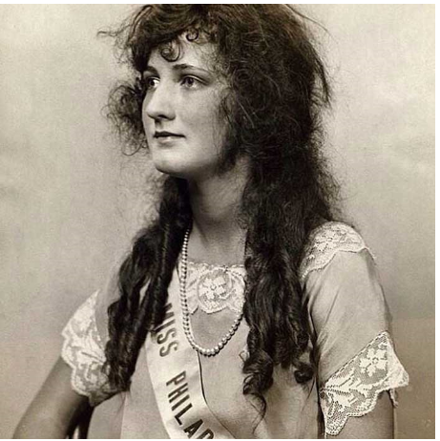
Miss America 1924

Slide 18
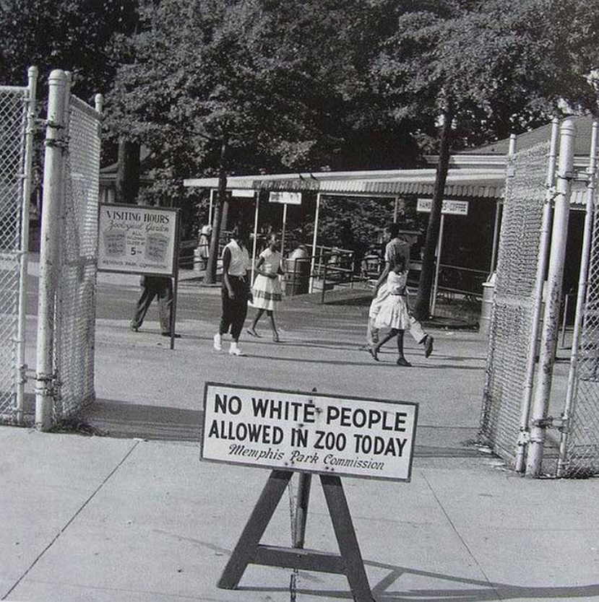
No white people allowed in zoo today, 1950s

Slide 19
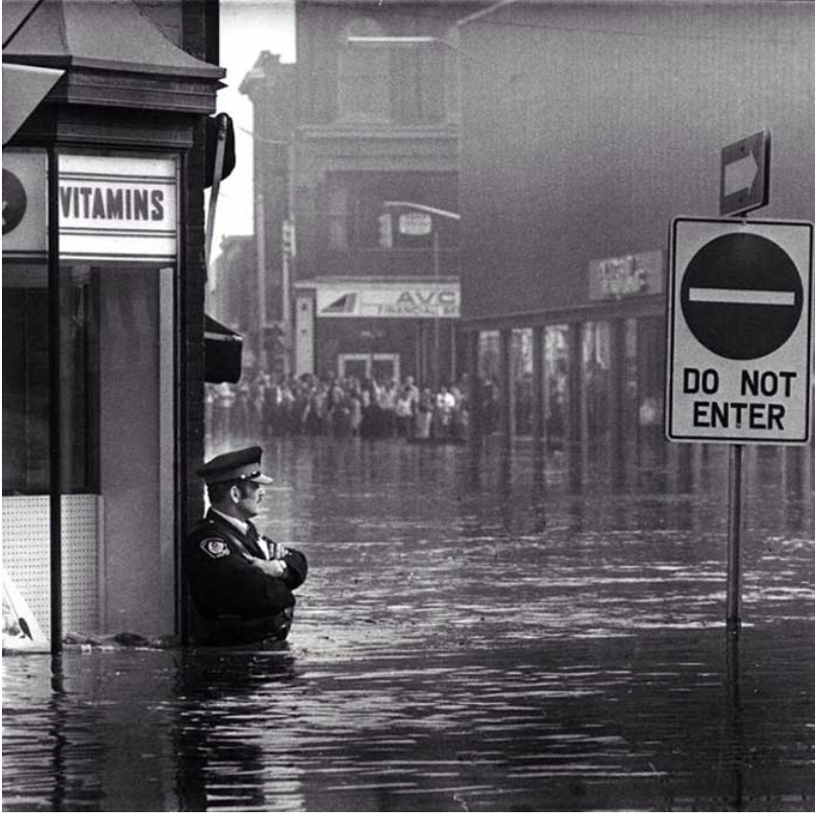
Police officer guarding Galt, Ontario pharmacy in waist-high flood waters, May 17, 1974

Slide 20
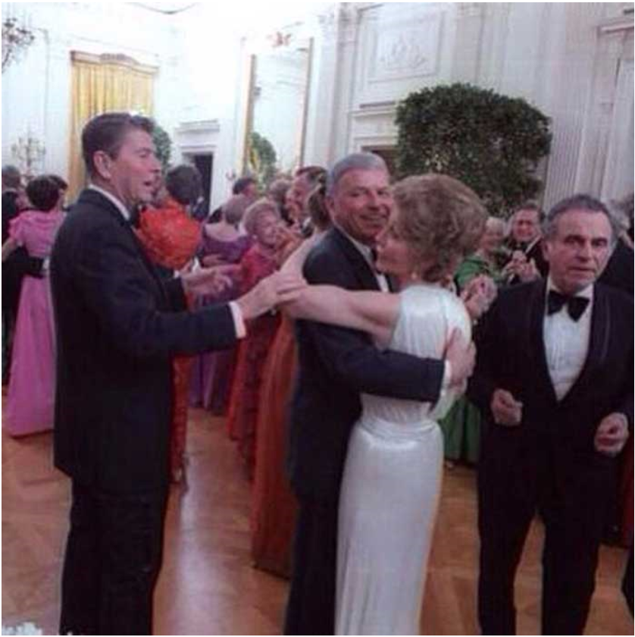
Ronald Reagan asking Frank Sinatra to stop dancing with his wife, 1981

Slide 21
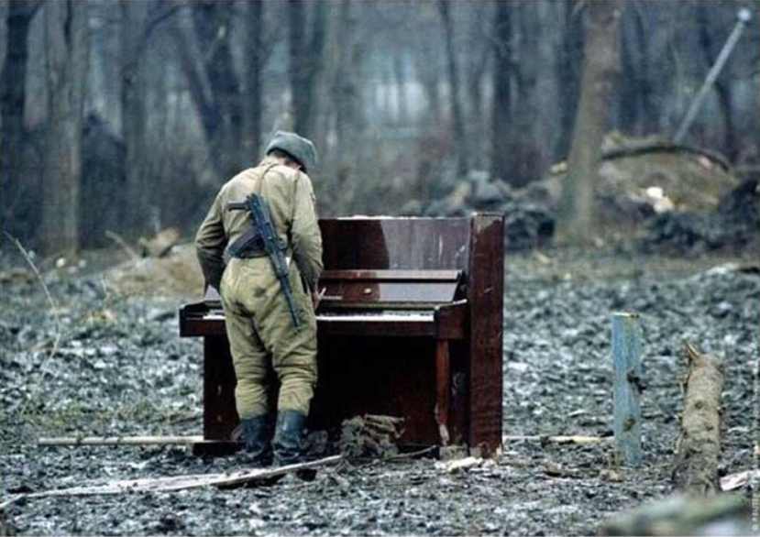
Russian soldier playing an abandoned piano, Chechnya, 1994

Slide 22
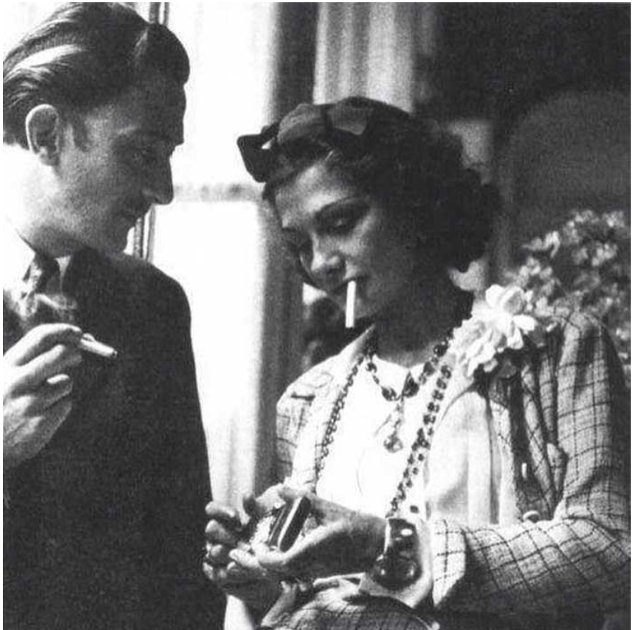
Salvador Dali and Coco Chanel

Slide 23
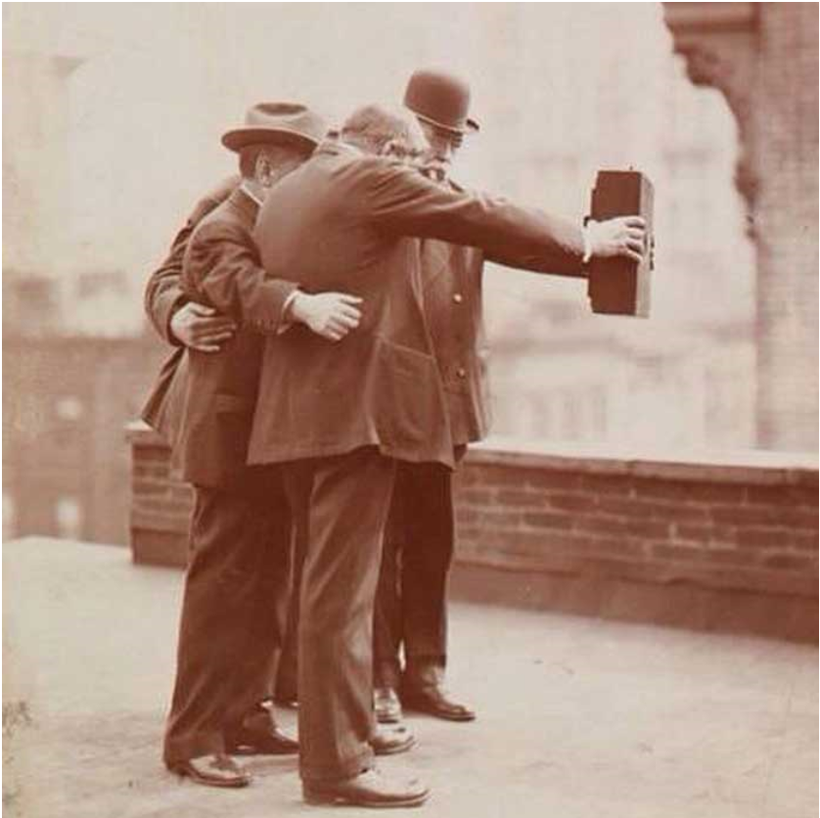
Selfies, 1920s

Slide 24
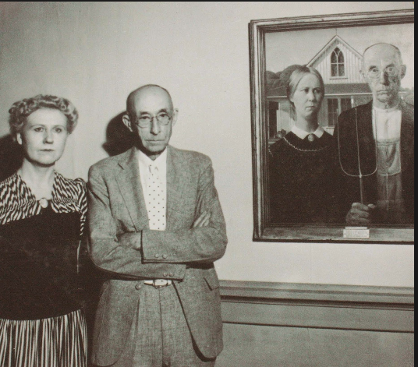
The models of "American Gothic" stand next to the painting

Slide 25
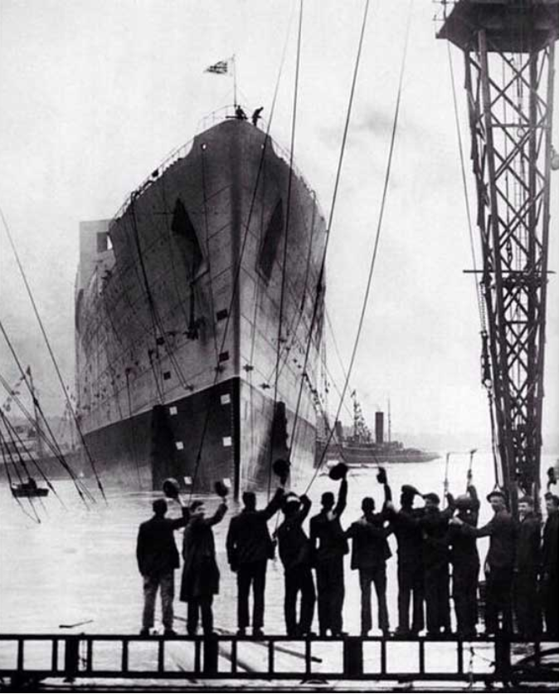
Titanic, 1912

Slide 26
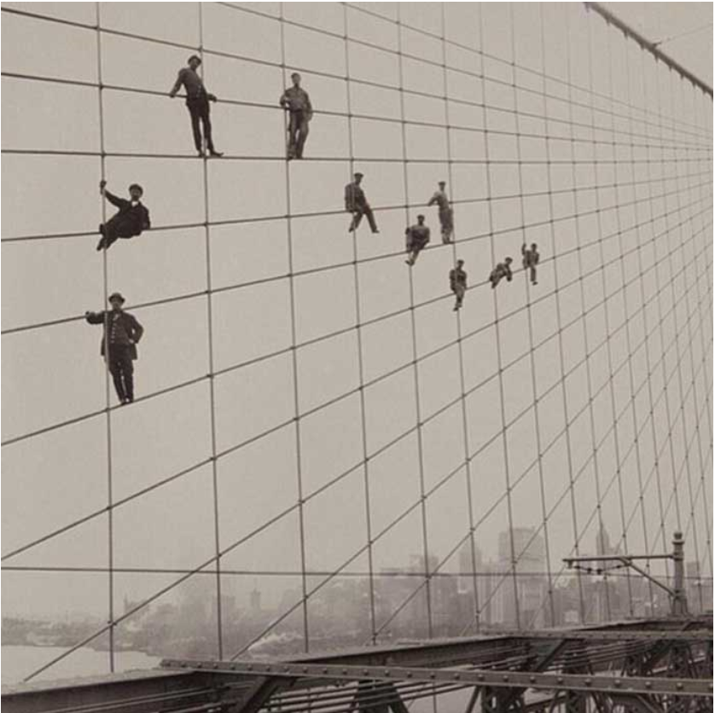
Workers pose more than 100 feet in the air during construction of the Brooklyn bridge

Slide 27
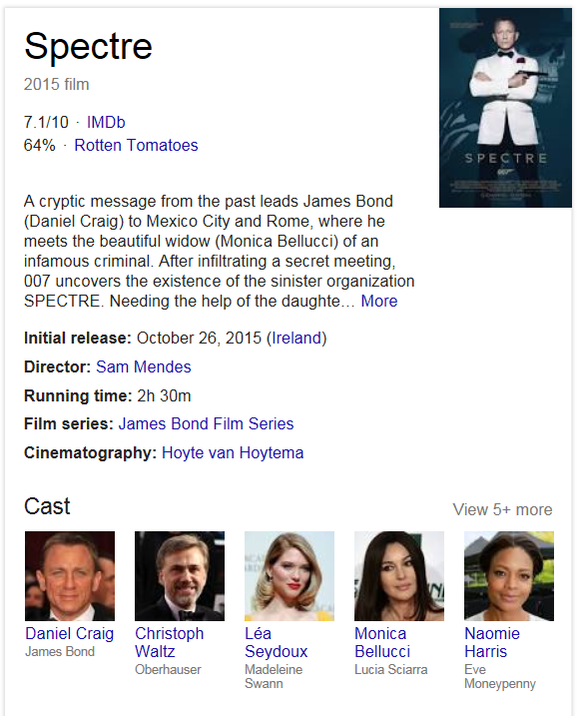
Records Management hits the Big Time!

