Slide 1
For Your Knowledge
Recordkeeping

Slide 2









What is a record?
All information you create, send or receive in the course of your job is potentially a record
No matter the form or format if it is evidence of business activity it is a record.
Notes:
All information you create, send and receive in the course of carrying out your job is potentially a record.
Whether something is a record or not depends on the information and the context - basically, if it is related to the business of the agency then it is a record.
For example, an email to your supervisor briefing them on a topical issue is a record, whereas an email to the same person letting them know their car window has been left open is not a record.
Records come in paper, electronic and other formats including: letters, faxes, email, maps and plans, information in business systems, databases, datasets, website pages, handheld device and SMS messages as well as images in photographs, film, video and DVD.
Depending on what business is being carried out, records can also be objects like samples and exhibits.
As government business is increasingly conducted electronically, records such as email and records of web transactions are becoming central to our daily work .
Possible Questions to the Group
Ask what records participants make in the course of their work:
What records are electronic? Examples include email, web transactions, information entered into databases and business systems like finance or HR management
systems.
What records are on paper? Examples include signed contracts, final reports and signed letters.
What records are images? Examples include maps, pictures, photos and surveillance film.
What records are objects? Examples include samples and exhibits.
Record formats include
Email, texts, instant messages, web site pages
Letters, drawings, diagrams, maps
Information in business systems and databases
Photographs, images, film, video, sound recordings

Slide 3
Why do records matter?
Records Matter in Business
Explain Actions & Decisions
Create & Maintain Evidence and Corporate Memory
Business Efficiency
Access & Sharing
Essential part of transparent and accountable government.
Provide evidence, explain actions, justify decisions and demonstrate process
Legal framework that requires government to make and keep records
Records Matter in Law
Document Rights & Entitlements
Notes:
Records are an essential part of transparent and accountable government. They help provide evidence, explain actions, justify decisions and demonstrate the process followed.
Law
The business of government operates within a legal framework that requires us to make and keep records:
Crimes (Document Destruction) Act 2006
The purpose of this Act is to amend the Crimes Act 1958 to create a new offence in relation to the destruction of a document or other thing that is, or is reasonably likely to be, required as evidence in a legal proceeding.
Evidence Act 1958
This Act describes the ways in which documents may be admitted as evidence into court. The Act describes the more acceptable formats and the features that would give more value or “weight” to records. Recordkeeping practices must ensure that the more appropriate format of the record is preserved.
Freedom of Information (FOI) Act 1982
The FOI Act contains the key provisions governing aspects of government recordkeeping, disclosure and public accountability. The FOI Act gives everyone the right to make a request to access “documents” held by Victorian Government Departments and Agencies. While Berry Street is not covered by this legislation it has chosen to do so as an open and transparent community service organisation and in accordance with organisational values
Information Privacy Act 2000
This Act creates a scheme for the responsible collection and handling of personal information. Recordkeeping practices must ensure that personal information is secure, accurate and only used for the purpose for which it was collected.
Business
Records are an essential part of transparent and accountable government. They help provide evidence, explain actions, justify decisions and demonstrate the process followed.
Records are valuable corporate assets. Making and keeping records makes good business sense for the agency in several ways:
• Records contribute to greater business efficiency.
• Records build corporate memory by embedding knowledge in an organisation.
• Records support improved productivity because they enable easy access to shared information needed to make the right decisions at the right time.
Records also help to document the rights and entitlements of individuals and organisations dealing with the agency. This is essential to ensuring that their interests are protected.
Making and keeping records will also make your job easier and help your colleagues by
enabling you to:
• find and use information, saving time and effort
• share information with colleagues
• re-use past work instead of having to re-invent the wheel
• recognise the most recent version of a document
• produce evidence when required to explain a decision
• protect you and your agency if something goes wrong, or if a decision or action is challenged,

Slide 4
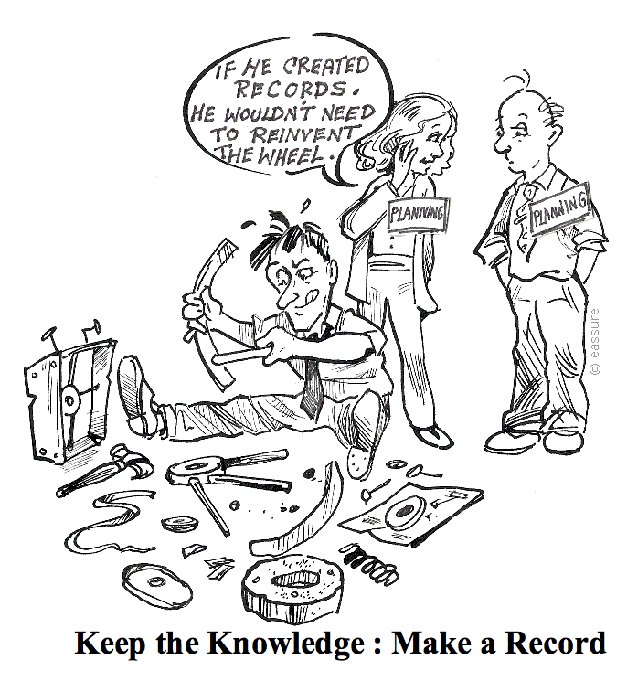
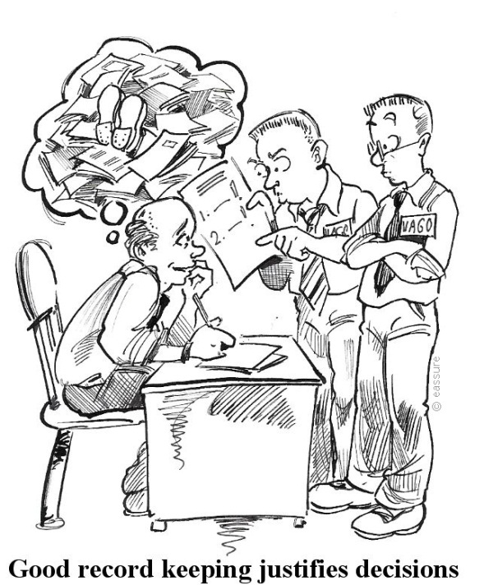
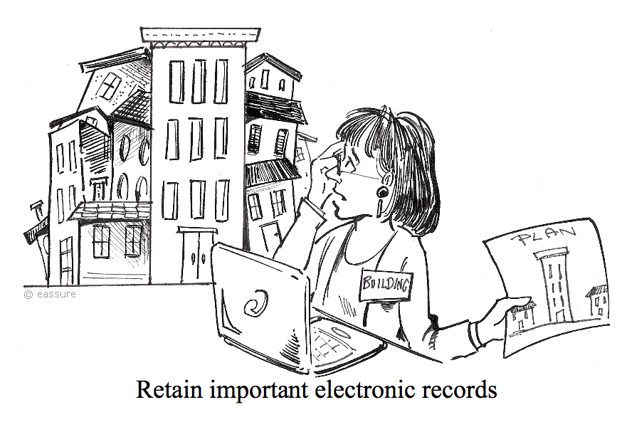
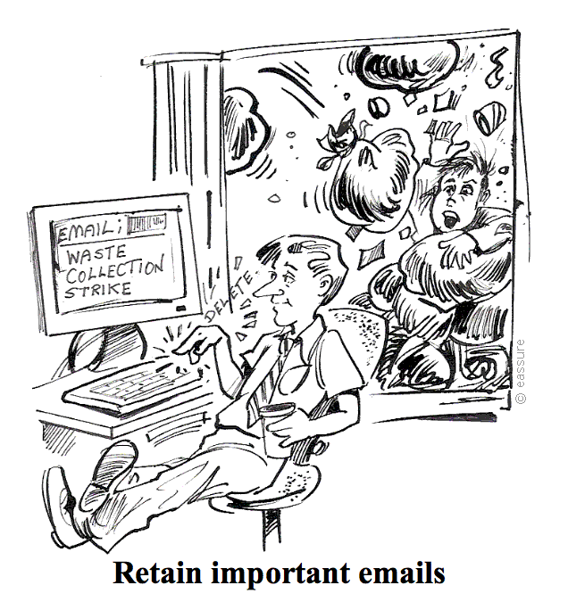
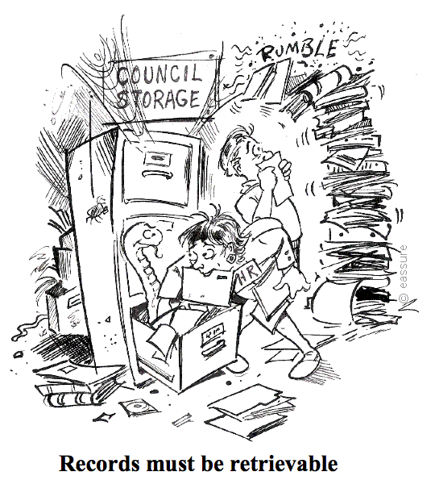
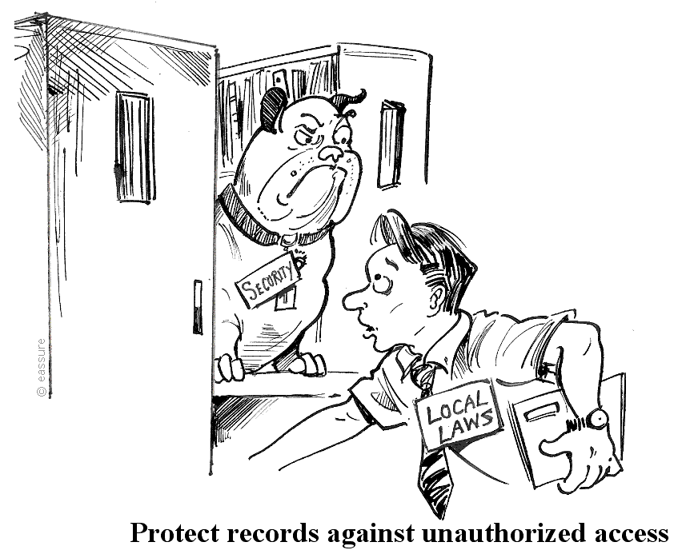
Your responsibilities?
Consider recordkeeping requirements
Ensure records are captured
Create full and accurate records
Familiarise yourself with agency recordkeeping policies
Ensure records include information that will allow others to easily understand
Only destroy records when authorised
Consider the sensitivity of the information
Only release records when authorised
Ensure safety and security of records
Notes:
Create full and accurate records of all my work-related decisions and activities.
Ensure records include information that will allow others to easily understand when, how, where, why and by whose authority actions took place and decisions were made.
Consider recordkeeping requirements when planning initiatives, projects and activities, and assign responsibility to team members for creating and managing the resulting records.
Ensure records are captured in accordance with agency policies and processes.
Ensure safety and security of records and the information they contain.
Consider the sensitivity of the information contained in records and ensure that records with personal, sensitive or confidential information are only accessible by authorised staff with a “need to know”.
Only release records when authorised to do so.
Only destroy records when authorised to ensure the records they create and receive are retained in an accessible format for as long as required.
Familiarise myself with organisational recordkeeping policies and practices and follow these. Where possible, take responsibility for improving records management practices in the workplace.

Slide 5
When do you make or keep records?
TO PROVIDE EVIDENCE OF
What
Happened
Was Decided or Recommended
Who
Was Involved
Who Decided/Recommended
When
It Happened
Order of events or decisions
Advice or instruction was given
Notes:
Because records provide evidence of our actions and link decisions and actions over time, make or keep a record when you need to show:
• what happened, when it happened and who was involved
• what was decided or recommended and by whom
• what advice or instruction was given
• the order of events or decisions.
Records should be made as closely as possible to the event they relate to. They also need to be:
• accurate and reflect the purpose they were created for
• detailed enough to suit the circumstances and be understood by others
• in proportion to the significance of the issues involved. For example, the documentation required for a $50 petty cash claim will be less than that for the purchase of expensive equipment.
You might need to make or keep a record of the following business activities:
phone calls and conversations
meetings
advice or directions
approvals and decisions
Use your judgement about whether a record is required in the circumstances.

Slide 6
Where can you get help or more information?
Records Management Staff
Supervisor/Manager
Intranet
Public Records Office Victoria

