Slide 1
For Your Knowledge
Recordkeeping

Slide 2
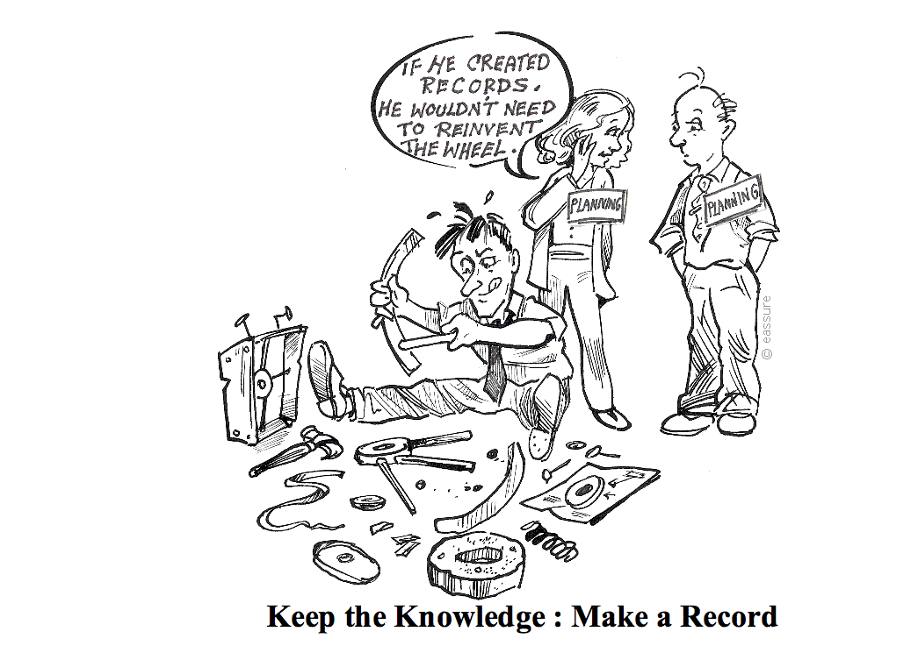
Everyone working for the agency, from entry level to head of agency, is required to make and keep records of their work.

Slide 3
What will you learn?
What is a record?
Why do records matter?
Your responsibilities?
When do you make or keep a record?
Can you delete or destroy records?
What if you are not sure?
What about access to records?
What else should you consider?
Where can you get help or more information

Slide 4









What is a record?
All information you create, send or receive in the course of your job is potentially a record
No matter the form or format if it is evidence of business activity it is a record.
Notes:
All information you create, send and receive in the course of carrying out your job is potentially a record.
Whether something is a record or not depends on the information and the context - basically, if it is related to the business of the agency then it is a record.
For example, an email to your supervisor briefing them on a topical issue is a record, whereas an email to the same person letting them know their car window has been left open is not a record.
Records come in paper, electronic and other formats including: letters, faxes, email, maps and plans, information in business systems, databases, datasets, website pages, handheld device and SMS messages as well as images in photographs, film, video and DVD.
Depending on what business is being carried out, records can also be objects like samples and exhibits.
As government business is increasingly conducted electronically, records such as email and records of web transactions are becoming central to our daily work .
Possible Questions to the Group
Ask what records participants make in the course of their work:
What records are electronic? Examples include email, web transactions, information entered into databases and business systems like finance or HR management
systems.
What records are on paper? Examples include signed contracts, final reports and signed letters.
What records are images? Examples include maps, pictures, photos and surveillance film.
What records are objects? Examples include samples and exhibits.
Record formats include
Email, texts, instant messages, web site pages
Letters, drawings, diagrams, maps
Information in business systems and databases
Photographs, images, film, video, sound recordings

Slide 5
Why do records matter?
Records Matter in Business
Explain Actions & Decisions
Create & Maintain Evidence and Corporate Memory
Business Efficiency
Access & Sharing
Essential part of transparent and accountable government.
Provide evidence, explain actions, justify decisions and demonstrate process
Legal framework that requires government to make and keep records
Records Matter in Law
Document Rights & Entitlements
Notes:
Records are an essential part of transparent and accountable government. They help provide evidence, explain actions, justify decisions and demonstrate the process followed.
Law
The business of government operates within a legal framework that requires us to make and keep records:
Crimes (Document Destruction) Act 2006
The purpose of this Act is to amend the Crimes Act 1958 to create a new offence in relation to the destruction of a document or other thing that is, or is reasonably likely to be, required as evidence in a legal proceeding.
Evidence Act 1958
This Act describes the ways in which documents may be admitted as evidence into court. The Act describes the more acceptable formats and the features that would give more value or “weight” to records. Recordkeeping practices must ensure that the more appropriate format of the record is preserved.
Freedom of Information (FOI) Act 1982
The FOI Act contains the key provisions governing aspects of government recordkeeping, disclosure and public accountability. The FOI Act gives everyone the right to make a request to access “documents” held by Victorian Government Departments and Agencies. While Berry Street is not covered by this legislation it has chosen to do so as an open and transparent community service organisation and in accordance with organisational values
Information Privacy Act 2000
This Act creates a scheme for the responsible collection and handling of personal information. Recordkeeping practices must ensure that personal information is secure, accurate and only used for the purpose for which it was collected.
Business
Records are an essential part of transparent and accountable government. They help provide evidence, explain actions, justify decisions and demonstrate the process followed.
Records are valuable corporate assets. Making and keeping records makes good business sense for the agency in several ways:
• Records contribute to greater business efficiency.
• Records build corporate memory by embedding knowledge in an organisation.
• Records support improved productivity because they enable easy access to shared information needed to make the right decisions at the right time.
Records also help to document the rights and entitlements of individuals and organisations dealing with the agency. This is essential to ensuring that their interests are protected.
Making and keeping records will also make your job easier and help your colleagues by
enabling you to:
• find and use information, saving time and effort
• share information with colleagues
• re-use past work instead of having to re-invent the wheel
• recognise the most recent version of a document
• produce evidence when required to explain a decision
• protect you and your agency if something goes wrong, or if a decision or action is challenged,

Slide 6
Your Responsibilities?
All Employees
Must comply with mandatory records management Standards and Specifications, established under the authority of the Public Records Act 1973.
Supervisors and Managers
Promote culture of good records management.
Know your agency’s records management requirements.
Provide training, resources and guidance for staff.
Notes:
Making and keeping records and information helps you to work more effectively and is an essential requirement of a diligent, efficient and responsible employee.
If you are a supervisor or manager, you can help improve records and information‘ management practices within your team and work area by promoting a culture of good records management.
To do this supervisors and managers need to:
• understand and promote their agency's records management policies and procedures, and consider records management issues within their teams
• ensure staff have training and ongoing support to manage their records effectively
• ensure staff have time and resources available for records management
• build records management into projects (so it is not left to the end)
• include good records management practices in performance agreements .

Slide 7
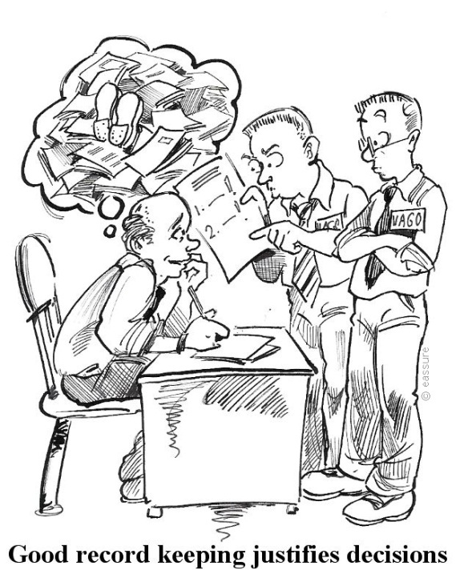
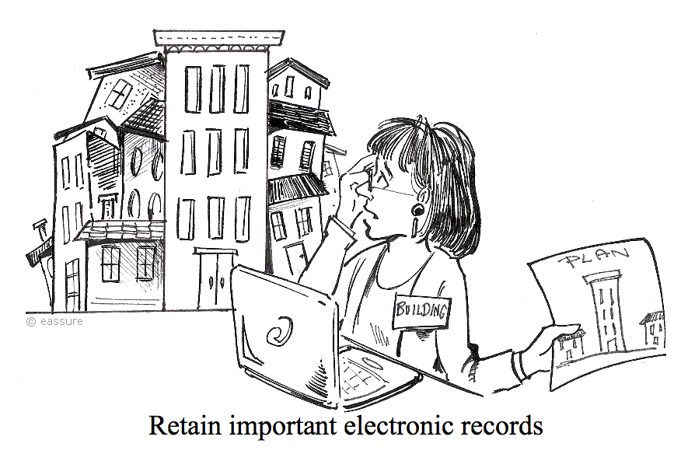
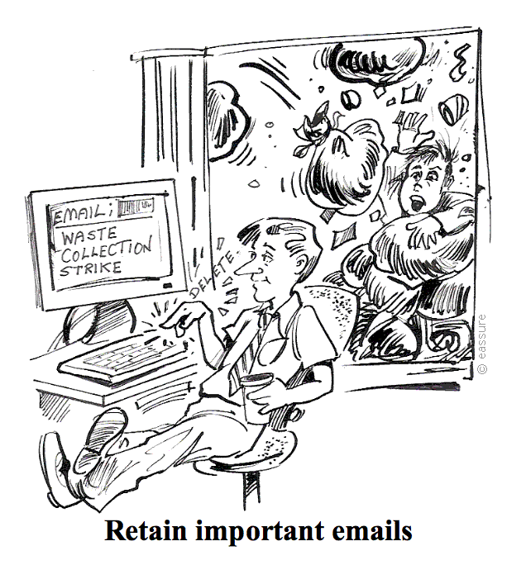
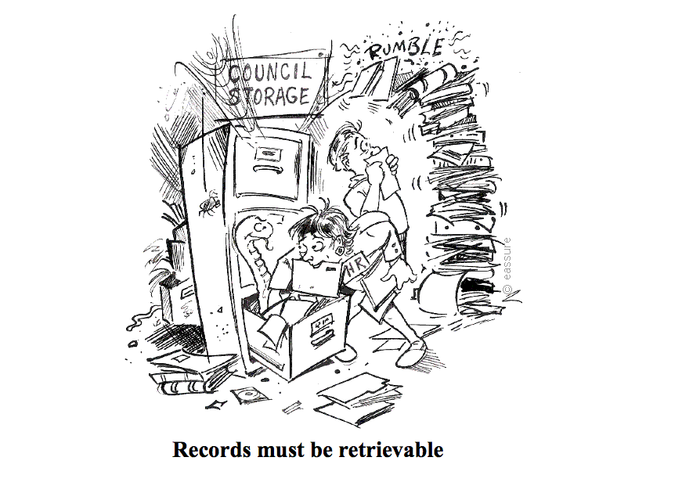
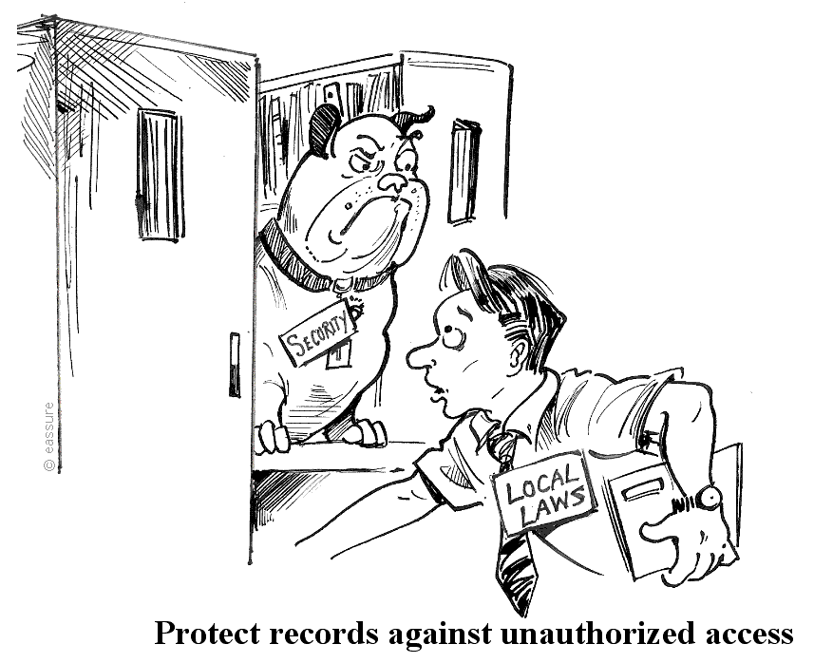
Your responsibilities?
Consider recordkeeping requirements
Ensure records are captured
Create full and accurate records
Familiarise yourself with agency recordkeeping policies
Consider the sensitivity of the information
Only destroy records when authorised
Only release records when authorised
Ensure security of records
Notes:
Create full and accurate records of all my work-related decisions and activities.
Ensure records include information that will allow others to easily understand when, how, where, why and by whose authority actions took place and decisions were made.
Consider recordkeeping requirements when planning initiatives, projects and activities, and assign responsibility to team members for creating and managing the resulting records.
Ensure records are captured in accordance with agency policies and processes.
Ensure safety and security of records and the information they contain.
Consider the sensitivity of the information contained in records and ensure that records with personal, sensitive or confidential information are only accessible by authorised staff with a “need to know”.
Only release records when authorised to do so.
Only destroy records when authorised to ensure the records they create and receive are retained in an accessible format for as long as required.
Familiarise myself with organisational recordkeeping policies and practices and follow these. Where possible, take responsibility for improving records management practices in the workplace.

Slide 8
When do you make or keep records?
TO PROVIDE EVIDENCE OF
What
Happened
Was Decided or Recommended
Who
Was Involved
Who Decided/Recommended
When
It Happened
Order of events or decisions
Advice or instruction was given
Notes:
Because records provide evidence of our actions and link decisions and actions over time, make or keep a record when you need to show:
• what happened, when it happened and who was involved
• what was decided or recommended and by whom
• what advice or instruction was given
• the order of events or decisions.
Records should be made as closely as possible to the event they relate to. They also need to be:
• accurate and reflect the purpose they were created for
• detailed enough to suit the circumstances and be understood by others
• in proportion to the significance of the issues involved. For example, the documentation required for a $50 petty cash claim will be less than that for the purchase of expensive equipment.
You might need to make or keep a record of the following business activities:
phone calls and conversations
meetings
advice or directions
approvals and decisions
Use your judgement about whether a record is required in the circumstances.

Slide 9
Can you delete or destroy records?
Public records must only be disposed of in accordance with the requirements of the Public Records Act 1973 and any other legislation that impacts an agency’s recordkeeping requirements and responsibilities.
Before you decide to delete or destroy records you must:
find out which records you are responsible for keeping
find out which records you can delete or destroy
follow authorised procedures
ask your records manager for assistance.
NAP
RDA
SIDA
Notes:
It is an offence to unlawfully destroy a public record.
Do not destroy records that are the subject of a current Freedom of Information (FOI) request.
Crimes (Document Destruction) Act 2006 makes it an offence to destroy a document or other object that is reasonably likely to be required in evidence of a legal proceeding.
The PROV Disposal Standard defines three processes that can lead to the legal destruction of records:
Destruction of records under Normal Administrative Practice (NAP).
Destruction of records covered by a Retention & Disposal Authority (RDA).
Single Instance Disposal Authorities not covered by NAP or an existing RDA.
Normal Administrative Practice (NAP)
Public records may be destroyed by a public sector employee without any authorisation from PROV provided that they fall within the category of Normal Administrative Practice (NAP). NAP allows for the disposal of:
Working documents consisting of rough notes and calculations used only as a means to assist in the preparation of other records such as correspondence, reports and statistical tabulations.
Drafts not intended for retention as part of the agency’s records, the content of which has been reproduced and incorporated in the agency’s recordkeeping system.
Additional copies of documents, emails and publications maintained for reference purposes.
Retention & Disposal Authorities (RDAs)
Retention & Disposal Authorities (RDAs) specify the minimum retention periods for classes of records and authorise the destruction of time-expired records.
All RDAs, whether general or specific to a particular agency, do not attempt to describe each particular record type or format, but instead provide a broad description of the functions and activities to which the records relate.
Single Instance Disposal Authorities (SIDA) - Formerly ad-hoc disposal authorities.
To destroy any record not covered by either NAP or an RDA, it is necessary to be issued with a Single Instance Disposal Authority (SIDA) from PROV. These are typically used for:
Records of functions or activities which are no longer performed by the agency.
Records inherited by an agency as a result of machinery of government changes (that is, an agency inheriting a function previously undertaken by a different agency).

Slide 10
What if you are not sure?
Make a RECORD
Is an ACTION required?
Will it be NEEDED in the future?
Is it WORK related?
Was it MADE, SENT or RECEIVED for work?
Was it used to make a DECISION?
Notes:
Some records are created automatically for you, like those generated in workflow or business information systems (eg many human resources and finance systems). At other times you will need to make a decision to make or keep a record.
If you are not sure whether you should make or keep a record, ask yourself the following questions:
• Did I send, receive or use this in the course of my work?
• Am I (or is someone else) required. to act on this?
• Will anyone need this information in the future?
If you answer yes to any of these questions, you should make or keep a record.
Records are created when we carry out the business of your agency. Common business activities where records might need to be made include:
• work related phone calls and conversations
• meetings
• when advice or directions are given
• when approvals and decisions are made.
Business related email should be managed as records:
Understand when you are responsible for capturing email.
Not all email you receive needs to be captured (eg personal or for information only email).
Capture email in corporate locations and systems.

Slide 11
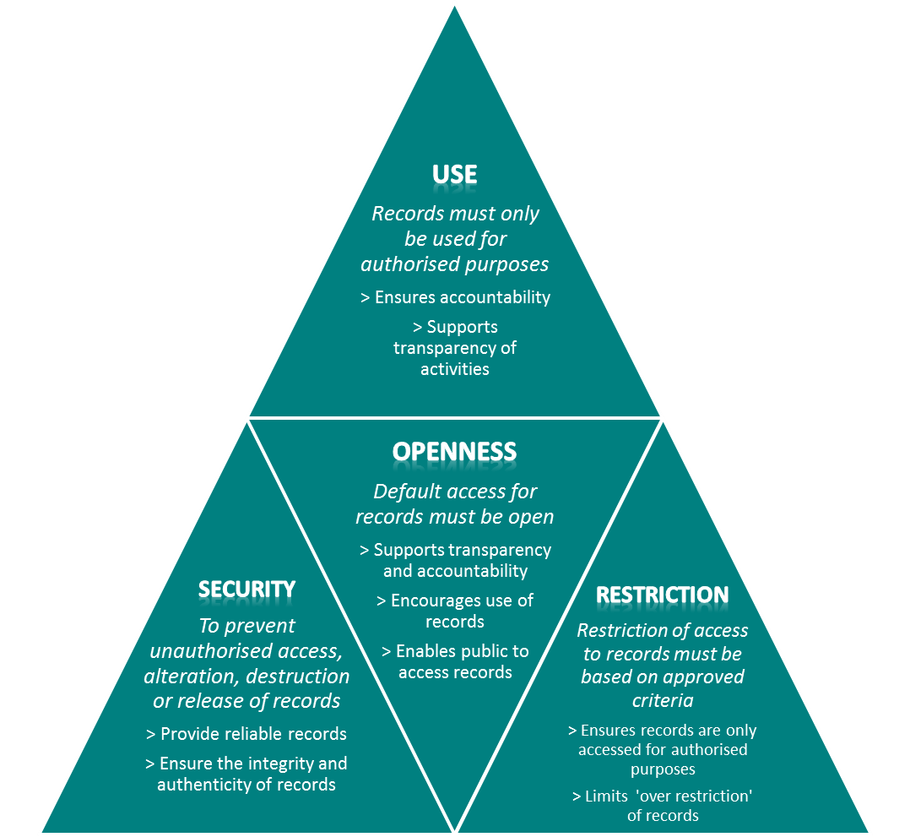
What about access to records?
Public access to records and information is legislated
Public Records Act 1973
Freedom of Information Act 1982
Information Privacy Act
2000
Notes:
Records should be accessible within your agency, unless access is restricted by either law or business requirement.
Records that need to be protected must be given a classification rating and captured in an appropriate secure location.
You need to be aware of when and how you can provide public access to information and records. You are not permitted to provide public access to agency information and records without appropriate authorisation.
Records should be accessible unless restricted
Restricted records must be marked and captured in a secure location.
Public access to records and information allowed only with agency approval.
The following legislation provides for members of the public to apply for access to government information and records:
• The Freedom of Information Act provides for public access to documents through a formal application process.
• The Public Records Act provides for public access to records more than 30 years old - also through a formal application process.
• The Information Privacy Act sets out the safeguards agencies must observe when collecting, storing, using and disclosing personal information. This Act
also gives the public some rights to access and correct information about themselves.
Your agency will have procedures in place for handling public requests for access received under these laws.

Slide 12
What else should you consider?
Control
Storage
Maintaining the context of records over time through assigning relevant metadata
Seamless records management through use of classification schemes and titling protocols
Accurate tracking of the location and actions relating to business records
Keep records in corporate locations and systems identified and approved by agency storage programme to ensure they are:
Readily accessible by those who require them for work
Secured from unauthorised access, tampering, deletion or loss
Related to other records
Backed up or saved from corruption to ensure business continuity
Notes:
CONTROL
Managing the control of records requires the development, implementation and alignment of recordkeeping systems and schemes across the agency. This includes:
Metadata - Metadata schemes are developed and implemented that meet agency business needs and are compliant with PROV Recordkeeping Standards.
Classification - Completed business classification scheme or schemes covering all areas of agency business. Procedures that document how business records are to be classified in accordance with the classification scheme.
Naming Records - When you are naming records make sure the titles:
are meaningful and easy to understand - anyone should be able to tell what the record is about by the title or name, not only the person or work area involved at the time the record was created
don't contain vague terms - terms like 'miscellaneous', 'general' or 'correspondence' do not provide enough information to show what the record is about, or its value
provide details that will distinguish between similar records - include additional information such as the date or version
spell out abbreviations and acronyms - abbreviations and acronyms can change or lose their meaning over time.
Tracking - The location of and actions related to business records are accurately tracked (this includes tracking records migrated from one system to another or which are being transferred for whatever duration to an external location).
STORAGE
Do not keep important business information in personal locations, such as your email folders or local hard drive, where it is inaccessible to others.
Also consider the security risks and do not keep sensitive or important information on laptops, CDs, USBs and other portable storage devices that can easily be misplaced, lost or stolen.
Keeping records at home or in your car also poses risks, as they could be accessed inappropriately or lost.

Slide 13
Where can you get help or more information?
Records Management Staff
Supervisor/Manager
Intranet
Public Records Office Victoria

